Slide 1
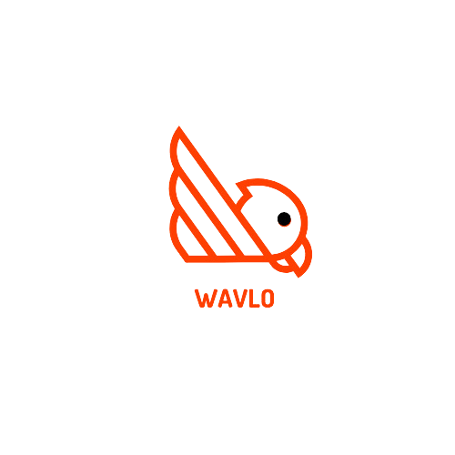

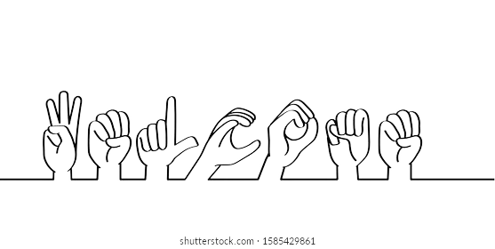
Wavlo
Breaking barriers, connecting worlds

Slide 2
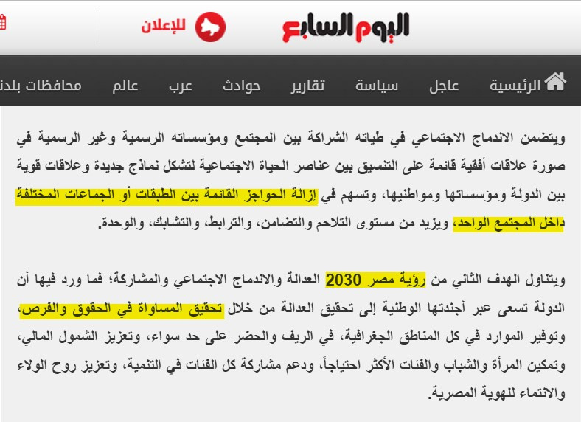
Egypt Vision 2030

Slide 3
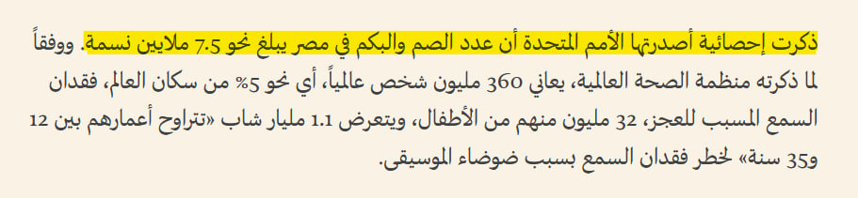

Target Audience

Slide 4

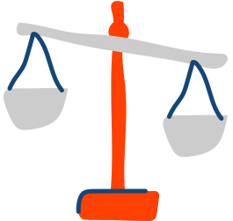


Comparison
Normal Person
Deaf & Mute Person

Slide 5
Wavlo
Breaking barriers, connecting worlds

Slide 6
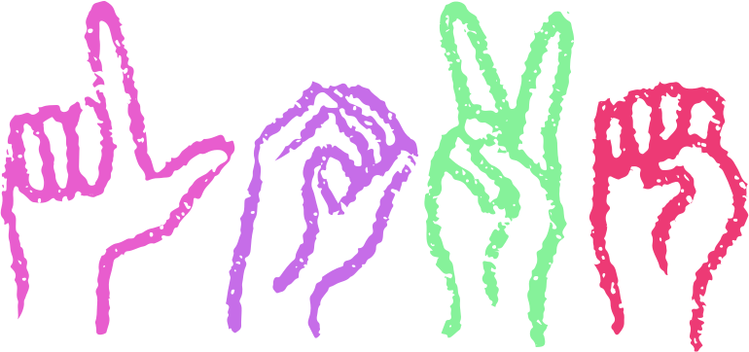
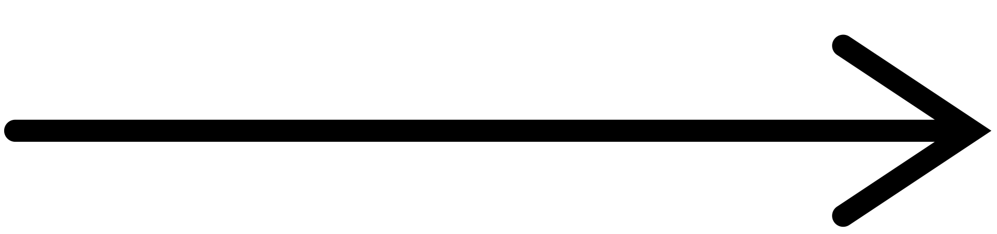
Deaf & Mute Person

Slide 7

Normal Person

Slide 8

Page 05

Slide 9

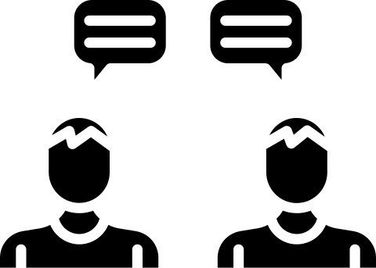
Page 04
Target Audience
B2C
B2B

Slide 10

PROBLEM
VALUE PROPOSITION
Deaf and mute individuals face significant communication barriers when trying to interact with customer service representatives.
Current solutions are either slow, prone to misunderstandings, or lack the real-time interaction needed for effective service.
Companies miss out on potential customers due to inaccessible customer support channels.
Wavlo enables seamless communication between deaf and mute individuals and customer service agents.
Provides an inclusive and accessible solution for better interaction, enhancing customer satisfaction and support experience.
Utilizes advanced AI technology for real-time sign language translation to text or voice, and vice versa.
SOLUTION
TARGET AUDIENCE
An AI-driven mobile app that allows deaf and mute users to send sign language videos that are translated to text or voice, enabling smooth communication with customer service agents.
Provides a two-way translation system where customer service agents’ voice messages are converted into text for the user, facilitating a clear exchange.
Supports multiple service industries, such as telecoms, banks, and airlines, to create a more inclusive customer service experience.
Primary: Deaf and mute individuals who need a better way to communicate with customer service.
Secondary: Companies in sectors like telecom, banking, and airlines that want to enhance their customer service accessibility and reach a broader customer base.
DESIGNED FOR :
WAVLO
DESIGNED BY :
TECH IT EASY
DATE :
12 - 1 - 2024

Slide 11
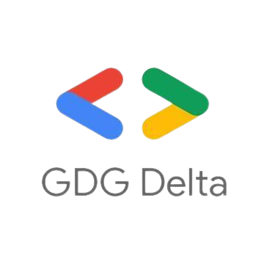
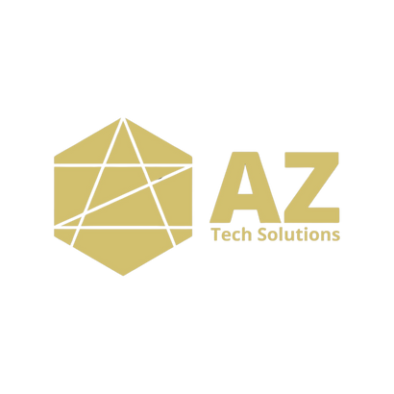

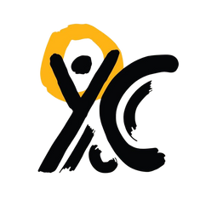
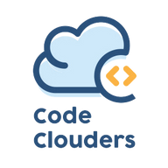
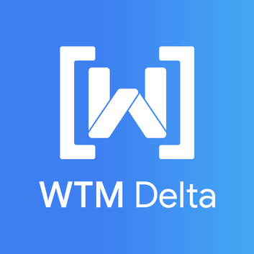
Thank You
For Your Attention

Slide 12








Page 05
KEY PARTNERS
CUSTOMER
SEGMENTS
VALUE PROPOSITIONS
CUSTOMER RELATIONSHIP
KEY ACTIVITIES
Organizations supporting the deaf and mute community.
Technology providers (cloud services, APIs).
Companies specializing in sign language training and interpretation.
Individuals who are deaf or mute.
Companies offering customer services (e.g., telecom companies, banks, airlines).
For individuals: Simplifying communication with customer service by converting sign language into text/voice and vice versa.
For companies: Enhancing customer experience and satisfaction for deaf and mute clients, increasing loyalty, and reducing loss of potential customers.
Continuous customer support through dedicated service.
Easy-to-use and efficient interface for both individuals and companies.
Developing and maintaining the application and platform for sign-to-text/voice translation.
Training AI systems for accurate sign language recognition.
Marketing the service to individuals and companies.
KEY
RESOURCES
CHANNELS
AI technologies for sign language recognition and speech translation.
High-quality datasets for training AI on sign language.
Mobile app for individuals.
An integrated platform (via API or subscription) for companies to use in their customer service systems.
BUSINESS MODEL CANVAS
COST STRUCTURE
REVENUE STREAM
Development and maintenance costs for the app and platform (programming, AI, hosting).
Marketing expenses to attract users and companies.
Costs of training AI systems on different sign languages.
Customer support expenses.
From individuals: Monthly subscription fee (e.g., 20 EGP per month).
From companies:
Monthly or yearly subscriptions.
Pay-per-interaction model for each communication session.

